Slide 1
DATA-DRIVEN DIGITAL TWIN
Group Members:
Pranav Teja 18AE3AI02
Arkaprava Ghosh 18MF10003
Nanisetty Sai Shailesh 18IM30013
Surampally Venkatesh 18AE3AI05
AI For Manufacturing
AI61009

Slide 2
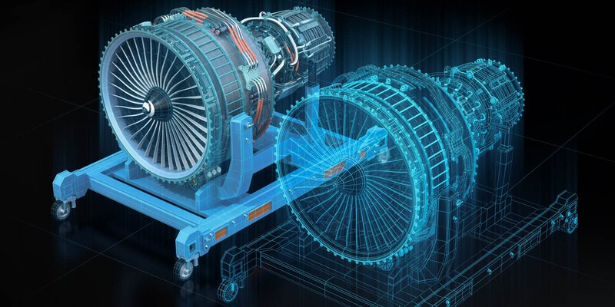
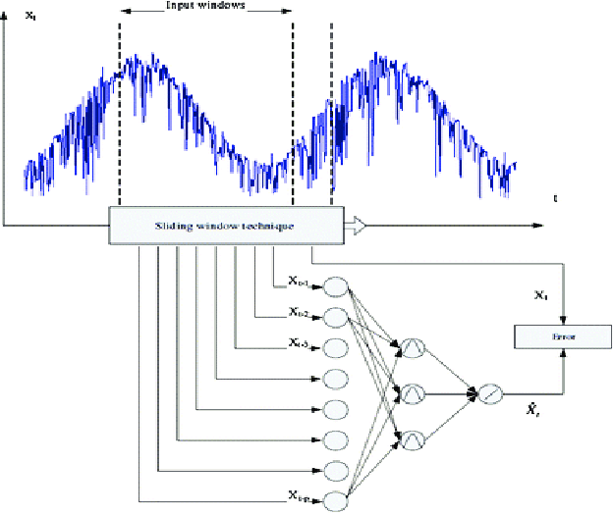
Data-driven digital twin and its importance in Industry 4.0

Slide 3
The Segmenter Class
class segmenter: def __init__(self,sequence_length): self.X_data = [] # List for time series data. self.y_data = [] # Labels self.l = sequence_length #Lookback period def addarray(self, data_t, class_type, n): done_locations = set() # Store index number of the records
i = 0 #For counting the size of generated data while i < n: # Randomly selecting staring location in the time series start = random.randint(0,len(data_t)-self.l) if start not in done_locations: # Check if this record is already generated i+=1 # Increase the count by one. done_locations.add(start) # Updating the completed record # Appending a sequence from start to start + lookback # period in to the training list self.X_data.append(data_t[start:start+self.l]) self.y_data.append(class_type) \\Appending the label def returndata(self): # Returning generated dataframe X_data = np.array(self.X_data) # Converting list to numpy array y_data = np.array(self.y_data) # Converting list to numpy array df = pd.DataFrame(X_data, columns = [col_names]) # making a data frame df['class'] = y_data # Adding classes column to the dataframe df = df.sample(frac=1) # Shuffling the records return df

Slide 4
Data Visualization & Insights- Part II
AI For Manufacturing
AI61009
Surampally Venkatesh

Slide 5
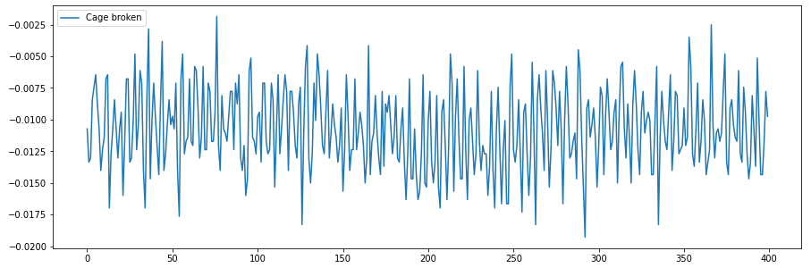
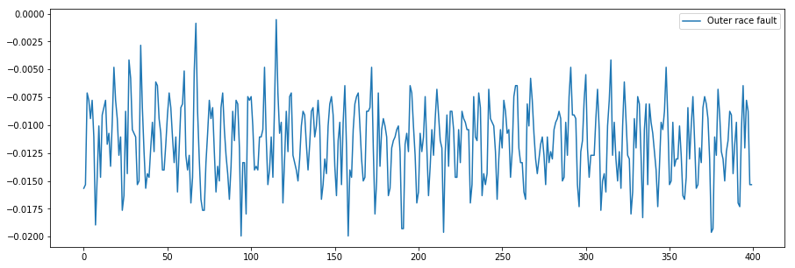
Power
Cage Broken
Outer Race Fault

Slide 6
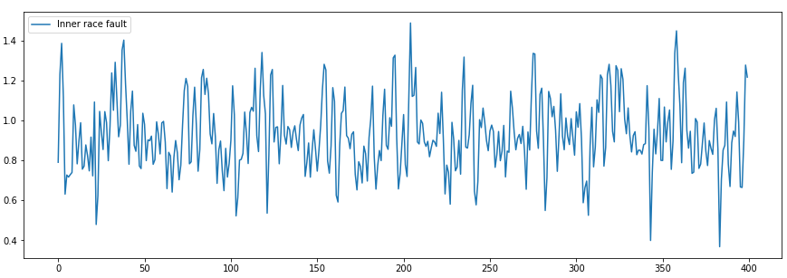
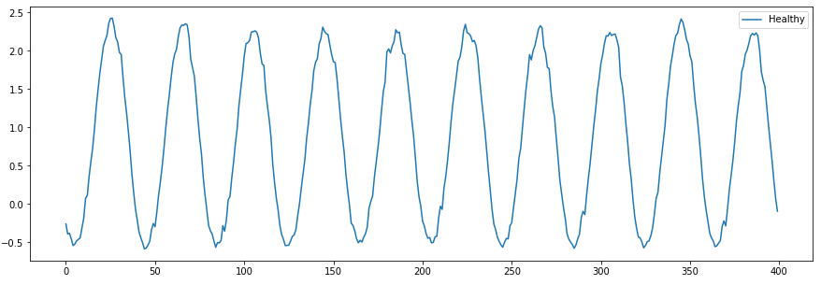
Power
Inner Race Fault
Healthy

Slide 7
Bi-directional LSTM Based Architecture
AI For Manufacturing
AI61009
Surampally Venkatesh

Slide 8
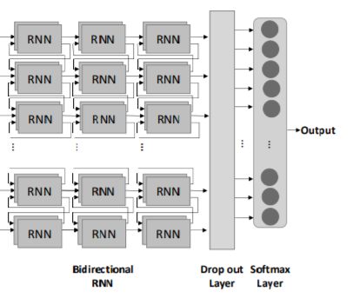
Bi-directional LSTM
At each time step within the sequence, the simple RNN takes advantage of the information learned from past states in generating the current state that will also be propagated to future states.
Learning sequential patterns in this way is important in many applications where the temporal component of the input data should not be ignored.
However, for identifying the failure, accessing the entire sequence at once could enable not only learning from past states but also from future states as shown in figure.
This can be achieved using bidirectional RNN, which incorporates two RNNs trained to make the output decision.
The first RNN operates from the beginning to the end of the sequence, while the other operates in the opposite direction.

Slide 9
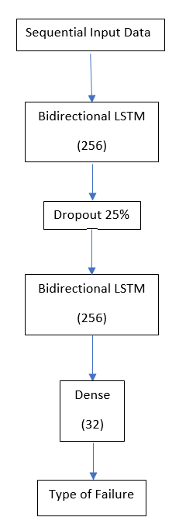
The high-level illustration of Neural Network Architecture for Failure identification
This model will be able to identify the type of failure.
Sequential time-series data is passed into the network with two Bidirectional LSTM layers with 256 neurons, a dense layer with 32 neurons and the Dropout layer with a 25% dropout to minimize the chances of overfitting.
Finally, a dense layer with a soft-max activation function is utilized to find the probability of the type of failure.

Slide 10
Results
Using this model we were able to achieve an accuracy of 55% on vibration data which is not acceptable.
The performance of the model is not up to the mark and can be understood that model is not able to learn much.
Accuracy : 55%

Slide 11
Data Visualization & Insights - Part I
AI For Manufacturing
AI61009
Nanisetty Sai Shailesh

Slide 12
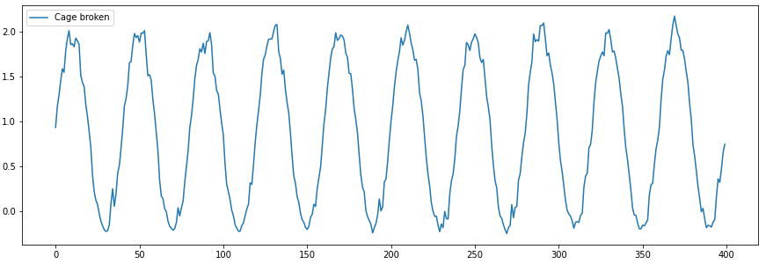
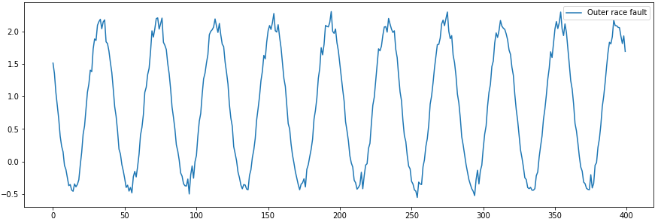
Vibration
In this, We are going to plot our dependent variable ‘Vibration’ with sequence length of 400 for the 4 datasets where each one represents a different class to get an idea of its behaviour.
Cage Broken
Outer Race Fault

Slide 13
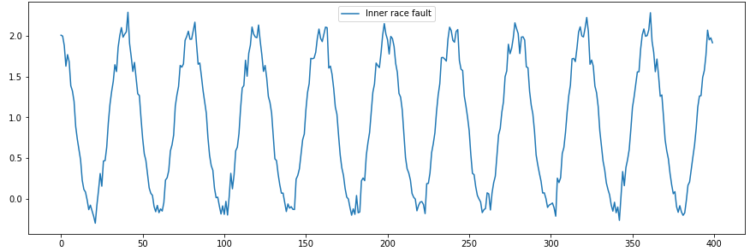
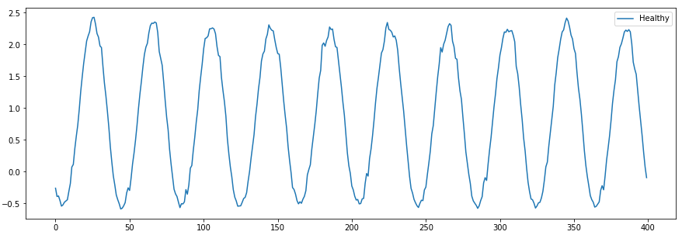
Inner Race Fault
Healthy

Slide 14
Key Insights:
From the above plots for this variable, we can observe that all the classes are showing periodic behavior and the periodicity is approximately 40 points.
Also, The peaks aren’t smooth and are instead showing zig-zag behaviour in Figures 1a,1b and 1c clearly indicating the defective nature of those classes unlike 1d where the peaks are almost perfectly smooth like that of sinusoidal.
Inner and Outer Race faults are especially showing more rigidity compared to Cage broken.

Slide 15
Classic LSTM Based Architecture
AI For Manufacturing
AI61009
Nanisetty Sai Shailesh

Slide 16
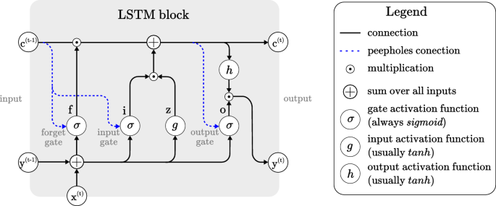
Vanilla LSTM
A Vanilla LSTM (a.k.a Classic LSTM) are a type of recurrent neural network capable of learning order dependence in sequence prediction problems.
Learning sequential patterns in this way is important in many applications where the temporal component of the input data should not be ignored.
This architecture consists of 3 main components: Input Gate, Output Gate and Forget Gate.
The forget gate chooses what values of the old cell state to get rid of, based on the current input data. The two input gates (often denoted i and j) work together to decide what to add to the cell state depending on the input.
i and j typically have different activation functions, which we intuitively expect to be used to suggest a scaling vector and candidate values to add to the cell state.Finally, the output gate determines what parts of the cell state should be passed on to the output.

Slide 17
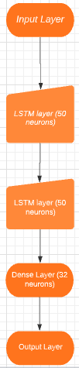
The high-level illustration of Vanilla LSTM Architecture for Failure identification
Before we even start building the model, we need to first transform the shape of training and test sets from 2d (samples,features) to 3d (samples, timesteps,features).
This is necessary as the LSTM will take in the input timesteps wise not all at once like the traditional Neural Nets.
Our model consists of 2 LSTM layers instead of 1 each composed of 50 neurons, a dense layer of 32 neurons.
Finally, a dense layer with a softmax activation function is utilized to find the probability of the type of failure.

Slide 18
Results
The training accuracy and test accuracy for the vibration model obtained was 96.5% and 95.8% respectively and their respective losses are 0.0845 and 0.1275..
The training accuracy and test accuracy for the power model obtained was 50.7% and 49.7% respectively and their respective losses were 2.34 and 2.78.
Clearly, This model performed well for the vibration whereas it dipped and isn’t accurate enough in the case of power.
So, there is further scope for a better model to be designed for giving accurate results on both variables.

Slide 19
Introduction
AI For Manufacturing
AI61009
Arkaprava Ghosh

Slide 20
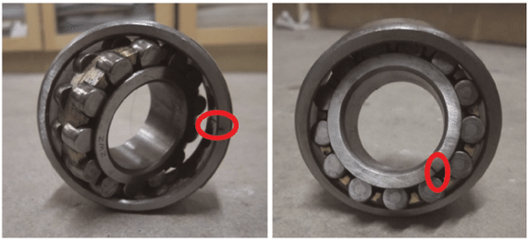
Types of Faults
We have broadly considered 4 types of bearing defects
Inner race fault: Any crack or fracture in the inner race of a ball or roller bearing causes what we call an inner race fault.
Outer race fault: When cracks or fractures happen in the outer raceway, we term it an outer race fault. Raceway faults can occur due to true or false brinelling, lubricant failure, corrosion etc.
Cage Broken: The bearing cage (also called a separator or a retainer) is the metal structure that holds the rolling elements (balls or cylindrical rollers) in proper position and orientation so that they don’t group together. Cage damage includes cage deformation, fracture and wear, fracture of cage pillars etc. Possible causes include poor mounting (misalignment), large moment load, shock or large vibration.
Healthy When none of the aforementioned faults have been observed, we term it a healthy bearing.
outer raceway fault (left), inner raceway fault (right)

Slide 21
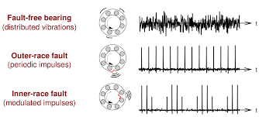
Vibration and fault
A healthy bearing only produces random vibrations (white noise) as expected.
Outer race faults theoretically produces periodic impulses ( due to periodic brinelling in the raceway).
Inner race faults display similar periodic behavior but generally with amplitude modulation.
Clearly the vibration pattern gives us significant insight into the bearing health.

Slide 22
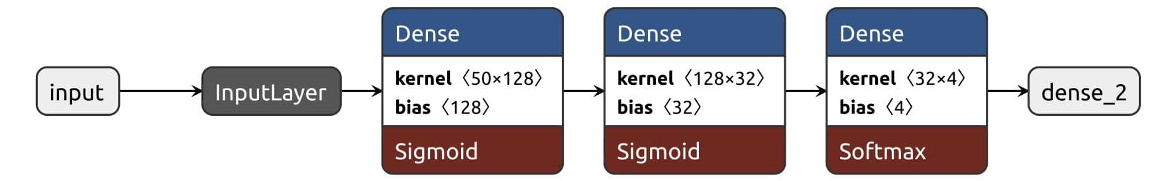
ANN approach
We consider a classic ANN approach here. Although it does not make a lot of sense using ANN for classifying a time series, we obtain good accuracies on the training set (~96.8%). We used categorical cross-entropy as the loss function, ADAM as the optimizer and ran for 100 epochs with a batch-size of 512 samples over a dataset of 4,000,000 samples with a sequence length of 50 (considering only the last 50 signal inputs) only considering the vibration data since it shows significant prospects.

Slide 23
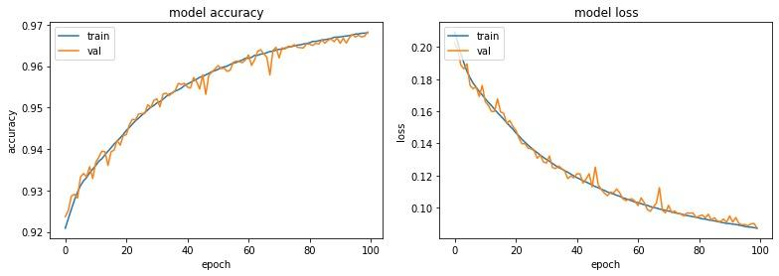
Results for the ANN approach
Vibration Signal
Validation set accuracy after 100 epochs = 96.80%
Test set accuracy = 96.88%, Test set loss = 0.0856

Slide 24
Conclusion
The various types of bearing faults, which form our output classes have been described.
Data visualizations performed helped us understand difference between the faulty and healthy classes.
We used ANN and LSTM based models to generate predictions
More complex models can be used with advanced sensor technology providing us multi dimensional data
We would like to investigate the combination of neural networks with signal processing techniques to get better results.

